Slide 1
Homeostatic Terms

Slide 2
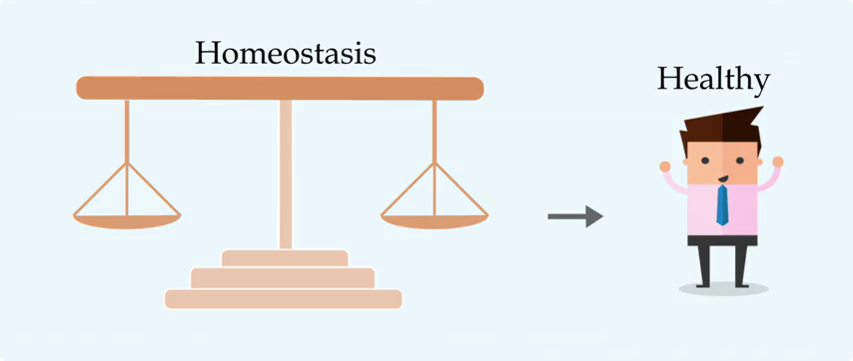
By the end of this Smart Lesson you should be able to:
Define variable, set point, and reference range.

Slide 3

In homeostasis, the variable is the part of the internal environment that the body is controlling.
For example, if you get too cold, you might shiver to warm up. In this case, you are regulating your internal temperature, so temperature is the variable.
Your body controls many variables at once, including body temperature, blood pH, ion concentrations, blood pressure, blood oxygen content, glucose levels and water levels.

Slide 4
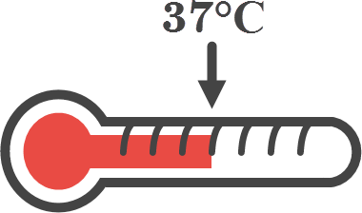
The set point is the ideal value for a variable.
The body will try to keep the variable near the set point.
For instance, the ideal temperature for a human body is around 37∘C. No matter how hot or cold it is outside, your body will try to maintain a temperature close to 37∘C.

Slide 5
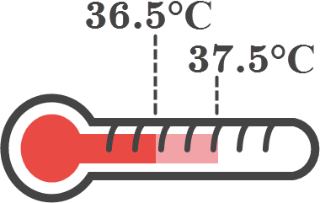
The reference range is the acceptable range of values for a variable.
So long as the body can keep the variable inside the reference range, the organism will remain healthy.
For example, while the ideal temperature for a human body is 37∘C, you will be healthy as long as your body temperature is somewhere between 36.5∘C and 37.5∘C.

Slide 6
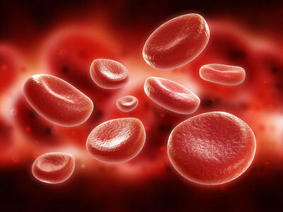
We've talked a lot about body temperature, another example is blood glucose levels.
Blood glucose level is the concentration of sugar in the blood, and is measured in mmol/L. An ideal blood glucose level is around 5 mmol/L, but a healthy person's blood glucose levels can be anywhere between 4 and 7 mmol/L.
Variable: | Blood glucose levels
Set point: | 5 mmol/L
Reference range: | 4 to 7 mmol/L

Slide 7

Let's review!
The variable is the thing the body is controlling, such as body temperature or blood pressure.
The set point is the ideal value for the variable.
The reference range is the acceptable range of values for the variable.

Slide 8
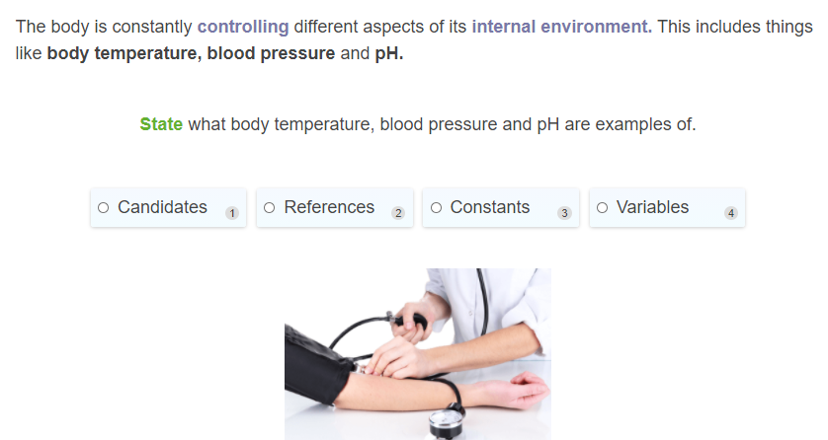

Slide 9
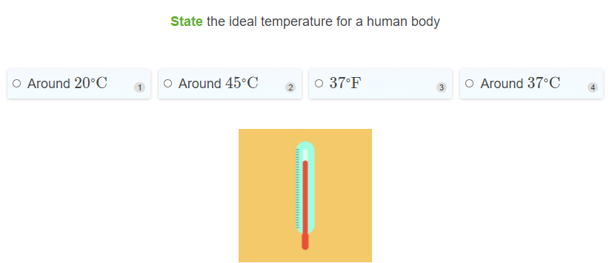

Slide 10
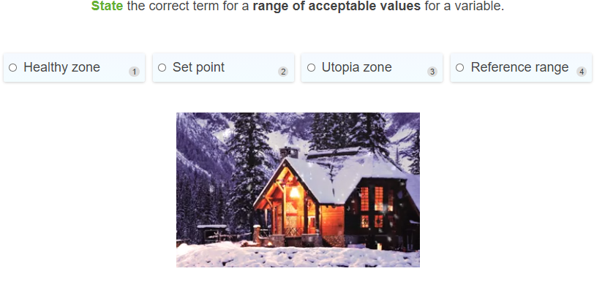

Slide 11
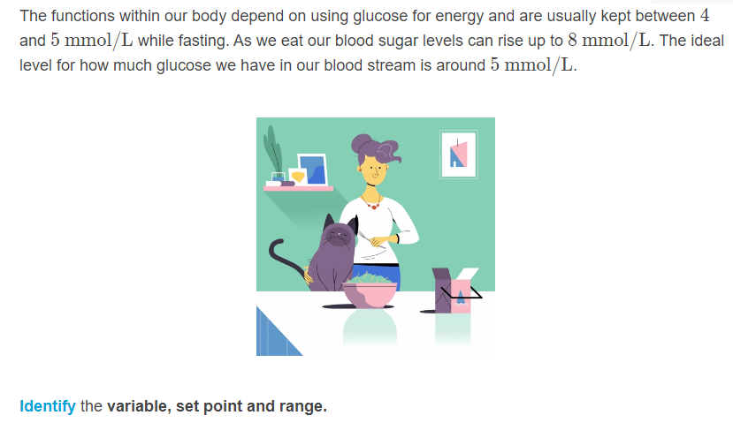

Slide 12
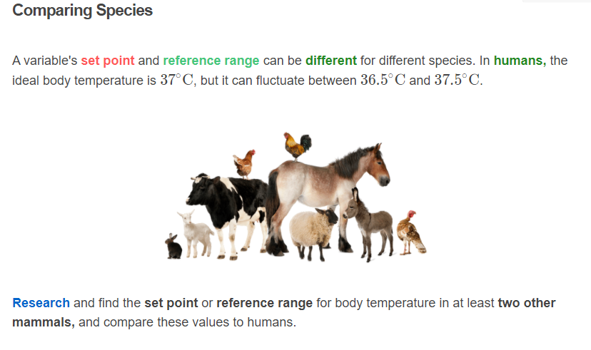

Slide 13
